Slide 1
Intelligent Cognitive Alarm Platform

Slide 2
Project Overview:
COGNIA is an intelligent alarm platform that encourages users to develop better waking habits through cognitive challenges and personalized reminders.
Key features:
❖ Alarm creation and management
❖ Cognitive puzzles and challenges
❖ User authentication and profile management
❖ Habit score and performance tracking
❖ Adaptive challenge difficulty and recommendations
❖ Notification and reminder system
Objective: To make waking up more interactive and encourage consistent daily routines.

Slide 3
Objectives:
❖ Encourage users to complete cognitive challenges.
❖ Reduce dependence on repeatedly snoozing alarms.
❖ Track wake-up performance and habit progress.
❖ Provide personalized recommendations.
❖ Deliver reminders and display progress through a dashboard.

Slide 4
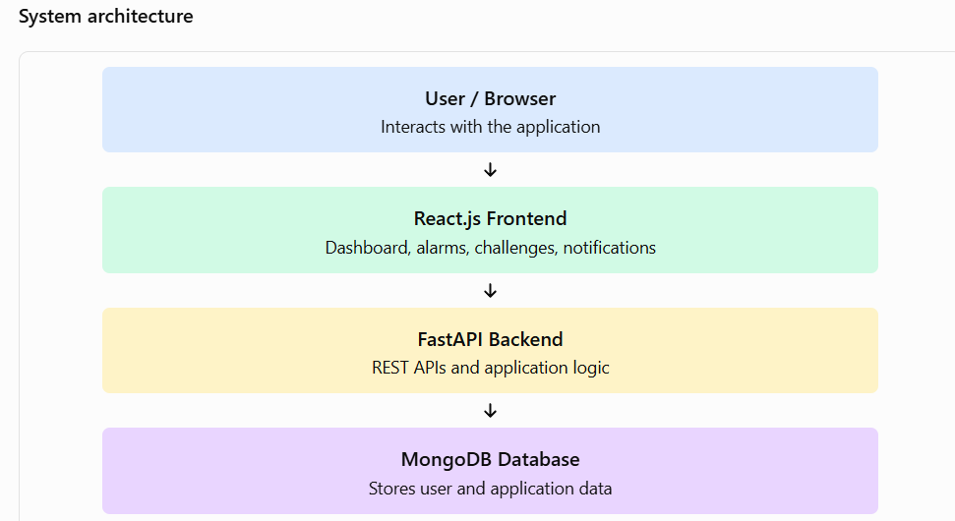
Technology Stack and Architecture
❖ Frontend: React.js and Vite
❖ Backend: Python and FastAPI
❖ Database: MongoDB
❖ API testing: Swagger UI
❖ Version control: Git and GitHub
❖ Containerization: Docker, where configured

Slide 5
Milestone 1: Authentication and Profile
Features implemented
❖ User registration and login
❖ Authentication and access control
❖ User profile management
❖ Storage and retrieval of user information
❖ Initial frontend and backend integration
Outcome: Established the basic user account system and project foundation.

Slide 6
Milestone 2: Alarms and Cognitive Challenges
Features implemented
❖ Alarm creation and management
❖ Cognitive challenges for wake-up interaction
❖ Challenge answer verification
❖ Integration between frontend and backend
❖ API endpoints for application operations
Outcome: Developed the core alarm workflow and challenge verification functionality.

Slide 7
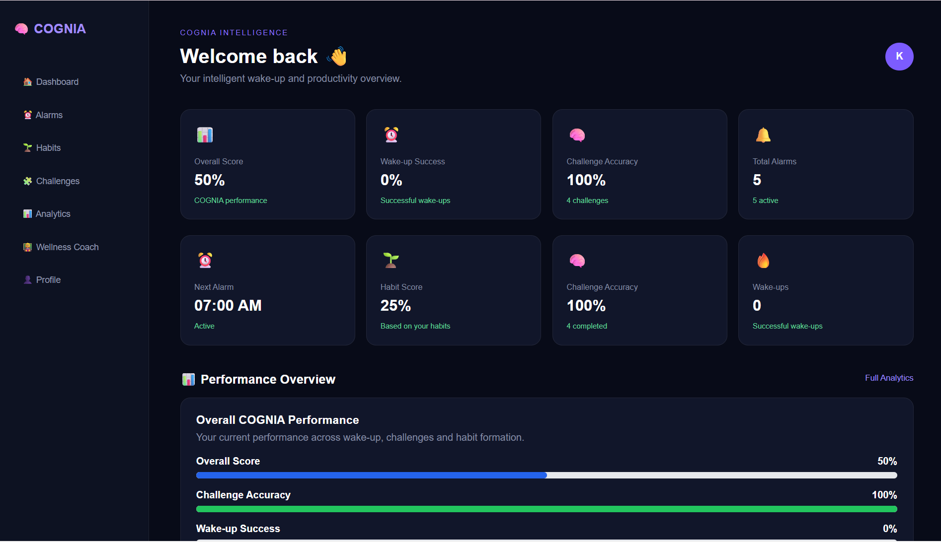
Milestone 3: Intelligent Features
Features implemented
❖ Habit score calculation
❖ Wake-up performance tracking
❖ Adaptive challenge difficulty logic
❖ Personalized recommendations
❖ Dashboard statistics and progress information
Outcome: Added intelligent behaviour and progress tracking to improve user engagement.

Slide 8
Milestone 4: Integration and Notifications
Work completed / demonstrated
❖ Integrated the project modules into the application.
❖ Created a Notifications page.
❖ Added an API to create notifications and reminders.
❖ Retrieved notifications using the user's email.
❖ Implemented a Mark as read feature.
❖ Tested notification endpoints using Swagger UI.
❖ Verified that reminders appear on the frontend.

Slide 9
Demonstration workflow:
❖ Start the backend and frontend.
❖ Open the application in the browser.
❖ Demonstrate the dashboard and project features.
❖ Create a reminder through Swagger UI.
❖ Refresh the Notifications page and display the reminder.
Deployment status: Source code is maintained in GitHub. Demonstrate Docker-based execution or public hosting only if configured and verified.

Slide 10
Conclusion and Future Enhancements
Conclusion:
COGNIA combines alarm management, cognitive challenges, habit tracking, adaptive logic, and notifications in one application. The milestone-based development approach helped build and integrate the main project features.
Future enhancements
❖ Mobile application support
❖ More cognitive challenge types
❖ Improved personalization using user behaviour
❖ Scheduled and automated reminders

Slide 11
Thank You
COGNIA — Wake Up. Think Better. Build Better Habits.

